Slide 1
FirstSchool: Improving the PreK-3rd Grade School Experience of African-American, Latino, and Low Income Children
Looking Back and Looking Ahead: Developing Strong Kindergartens within the PreK-3rd Continuum
New Jersey – October 28. 2011
Dr. Sharon Ritchie

Slide 2
Confluence of Work: PreK-3 is Growing
Foundation for Child Development
W.K. Kellogg Foundation
NAESP Task Force for Early Learning
New Jersey
National PreK-3rd Grade Work Group

Slide 3
FirstSchool
Cornerstones
Examining Relevant Data
Reciprocal Home-School Partnerships
Teaching for Learning
Responsive Leadership
Improving the School Experience for African-American, Latino, Low Income Children and their Families

Slide 4
Improve the school experiences of AALLI children
Focus on
research based practice that supports the success of AALLI children
data as a source for inquiry into inequity
the role of Kindergarten in getting AALLI children off to a positive start
( AALLI-African American, Latino and low income)

Slide 5
Research based practice that supports AALLI children
Oral language development and vocabulary development
Self-regulation and autonomy
Scaffolded instruction and reflection
Ability to collaborate and work with peers
Curriculum integration and connection to real world
Positive relationships with the adults in the classroom
Culturally responsive practices
Positive racial and ethnic identity development

Slide 6
FirstSchool Snapshot: Classroom Observation Measure
Minute-by-minute experience of children in PreK – 3rd grade classrooms
Activity Setting
Child Engagement
Teaching Approaches
Child Behavior
(Ritchie, S., Weiser, B., Kraft-Sayre, M., Mason, E., Crawford, G., & Howes, C., 2010)

Slide 7
Context for the Data Slides
The following slides are examples of data we use with PreK-Third Grade leadership and teachers.
Each school, grade level and individual teacher receives this type of data to help them inquire into their practices.
This data is particular to the contexts in which it is gathered and is not meant to be construed as representative.
We talk to teachers about this data in terms of practices that support AALLI children.

Slide 8
Minutes spent in activity settings by grade level

Slide 9
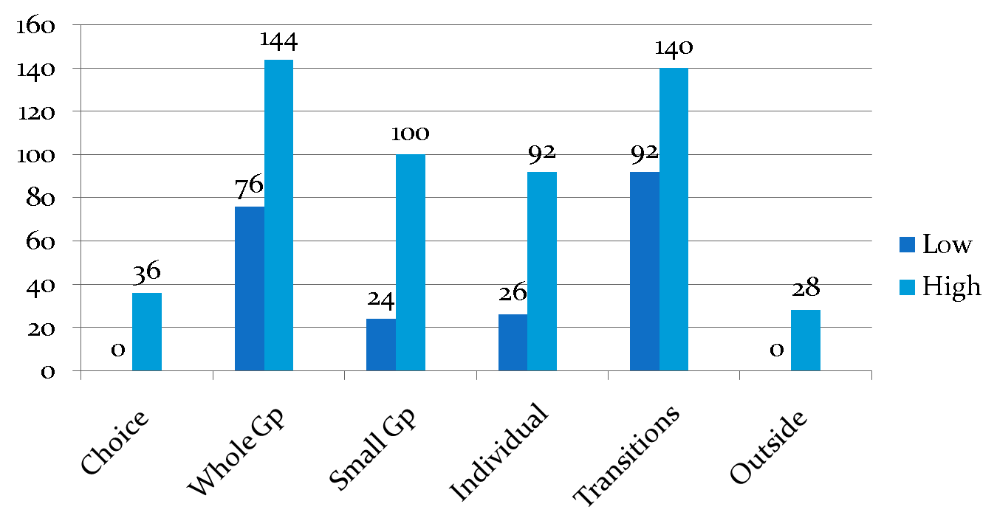
Settings: Range Across K Classrooms: Children in different classrooms have very different experiences

Slide 10
Student Inattention in Activity Settings:
What activity settings support optimal learning?

Slide 15
Classroom Assessment Scoring System
Instrument designed to measure the overall quality of interactions between students and teachers
Based upon extensive research and review of educational literature
Uses a 7-point scale to indicate the presence of key indicators and attributes
1-2 = low
3-5 = mid
6-7 = high
(Pianta, R. C., La Paro, K. M., & Hamre, B., 2008)

Slide 16
CLASS: Classroom Assessment Scoring System
Classroom Quality
Emotional Support
Positive Climate
Negative Climate
Teacher Sensitivity
Regard for Student Perspective
Classroom Organization
Behavior Management
Productivity
Instructional Learning Formats
Instructional Support
Concept Development
Quality of Feedback
Language Modeling

Slide 17
Context for the Data Slides
The following slides are examples of data we use with PreK-Third Grade leadership and teachers.
Each school, grade level and individual teacher receives this type of data to help them inquire into their practices
This data is particular to the contexts in which it is gathered and is not meant to be construed as representative
We talk to teachers about this data in terms of practices that support AALLI children

Slide 18
CLASS Averages: Across PreK-Third Grade FirstSchool Classrooms

Slide 19
CLASS Emotional Support by Grade Level: Across PreK-Third Grade FirstSchool Classrooms

Slide 20
CLASS Classroom Organization by Grade Level: Across PreK-Third Grade FirstSchool Classrooms

Slide 21
CLASS Instructional Support by Grade Level: Across PreK-Third Grade FirstSchool Classrooms

Slide 22
CLASS Dimension Averages: Across PreK-Third Grade FirstSchool Classr0oms

Slide 23
Thank you!

Slide 24
Contact Information
Dr. Sharon Ritchie
FPG Child Development Institute
University of North Carolina at Chapel Hill
sharon.ritchie@unc.edu
www.firstschool.us

Slide 25
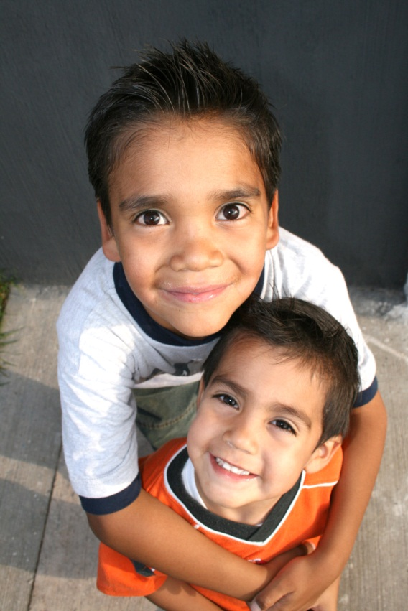
FirstSchool is supported by:
a grant from the W.K. Kellogg Foundation
The University of North Carolina at Chapel Hill
Private donors
FirstSchool.2011

Slide 26
FirstSchool is a project of the FPG Child Development Institute. FPG research and outreach have shaped how the nation cares for and educates young children.
www.fpg.unc.edu

